Slide 1
Embedded Ethics: The Ethics of Computer Game Design
Notes:
Licensed by the University of Toronto Embedded Ethics Education Initiative and Steve Engels, under the Attribution-NonCommercial-ShareAlike 4.0 International license. To view a copy of this license, visit https://creativecommons.org/licenses/by-nc-sa/4.0/.
Photo by Christina Morillo from Pexels (https://www.pexels.com/photo/person-using-macbook-pro-on-person-s-lap-1181298/)

Slide 2
Part 1:
Fun and Addiction
Notes:
Photo by Pixabay: https://www.pexels.com/photo/slice-grapefruit-209549/

Slide 3
More addictive
Less fun
More fun
In small groups, using these concepts as you understand them..
a) Name some games in each quadrant!
b) Suppose you removed the ludology techniques from each game. How would that change each game’s position? Draw an arrow for each game.
Less addictive

Slide 4
Discussion Question
Rank the following ludology techniques based upon:
How much fun they produce
How much addiction (or risk of addiction) they produce
Techniques:
Immersion
Communicating instructions to user
Achieving optimal challenge
Randomized rewards
Notes:
Background Image Source: Robin Higgins at pixabay (https://pixabay.com/photos/thinking-person-person-thinking-2681494/)

Slide 5
Addiction:
a disorder involving a persistent desire to engage in certain behaviour despite substantial harm to self or others
Notes:
Photo by cottonbro studio: https://www.pexels.com/photo/photo-of-man-standing-in-the-middle-of-the-crowd-8088452/

Slide 6
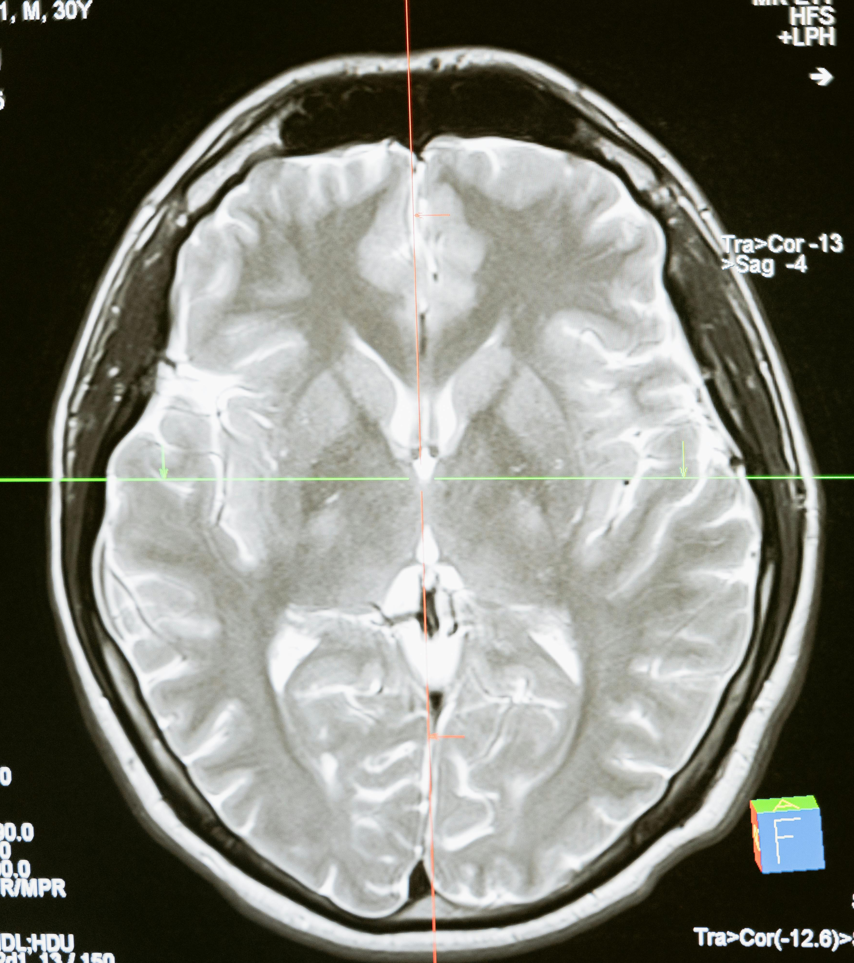
Playing computer games can also cause neurochemical changes: reduced dopamine response due to sensitization (Weinstein, 2010)
Notes:
Photo by MART PRODUCTION: https://www.pexels.com/photo/technology-computer-head-health-7089020/
For a long time, psychologists were reluctant to think of behaviour addictions as gambling.
To explain: what is dopamine? What is dopamine response and dopamine sensitization?
Weinstein, “Computer and Video Game Addiction—A Comparison between Game Users and Non-Game Users”, The American Journal of Drug and Alcohol Abuse (2010)
More recently, see Kuss, Pontes and Griffiths, Neurobiological Correlates in Internet Gaming Disorder: A Systematic Literature Review
(https://www.frontiersin.org/articles/10.3389/fpsyt.2018.00166/full)

Slide 7
Gaming addiction is recognized as a health disorder in some (but not all) classifications of psychiatric disorders.
Notes:
Taken from Wikipedia (fair use)

Slide 8
Q: How many people are affected in this way?
A: Lots of difficulty measuring - but prevalence estimated anywhere from 1% to 30% of the school-age population.
Some people are also severely affected by computer game addiction.
Griffiths, Kuss and King (2012)

Slide 9
Discussion Question
What sort of effects does video game addiction have on the lives of gamers?
To answer this question, go to the subreddit StopGaming and skim some of the posts
Notes:
Background Image Source: Robin Higgins at pixabay (https://pixabay.com/photos/thinking-person-person-thinking-2681494/)

Slide 10
To sum up so far:
Fun
(for most people)
Ludology techniques
Immersion
Stimulation
Randomness of Rewards
Addictiveness
(for some people)
Harm
Notes:
Notice one thing about the video (and the discussion so far): it doesn’t say anything about the designers responsibility. It’s mostly about how things look from the point of view of gamers.

Slide 11
Part 2:
Value Trade-offs: Fun vs Addiction
Notes:
Photo by Pixabay: https://www.pexels.com/photo/slice-grapefruit-209549/

Slide 12
Consider the following argument:
Computer games can cause addiction in some people.

Slide 13
Consider the following argument:
Computer games can cause addiction in some people.
Addiction is harmful.

Slide 14
Consider the following argument:
Computer games can cause addiction in some people.
Addiction is harmful.
We shouldn’t cause harm to others.

Slide 15
Consider the following argument:
Computer games can cause addiction in some people.
Addiction is harmful.
We shouldn’t cause harm to others.
Someone who makes something is responsible for the harms that it creates.

Slide 16
Consider the following argument:
Computer games can cause addiction in some people.
Addiction is harmful.
We shouldn’t cause harm to others.
Someone who makes something is responsible for the harms that it creates.
Conclusion: we shouldn’t make computer games

Slide 17
Q1) Do you agree with the conclusion of this argument? If not, what is mistaken about the argument? Is it one of the premises, or the argument itself?
Q2) If it is one of the premises, how would you rewrite that premise so that it is now true? What revised conclusion would that lead to?

Slide 18
Distributive justice: the ethics of distributing benefits and harms

Slide 19
Discussion Question
What are some other product or services (beside computer games) that provide benefits to many people but significant harms to a few people?
Notes:
Background Image Source: Robin Higgins at pixabay (https://pixabay.com/photos/thinking-person-person-thinking-2681494/)

Slide 20
Some possible principles for your consideration:
[You don’t have to endorse these principles, and you might think that they aren’t demanding enough! They are just to get you thinking…]

Slide 21
Some possible principles for your consideration:
[You don’t have to endorse these principles, and you might think that they aren’t demanding enough! They are just to get you thinking…]
You should never use ludology techniques just to increase addictiveness.

Slide 22
Some possible principles for your consideration:
[You don’t have to endorse these principles, and you might think that they aren’t demanding enough! They are just to get you thinking…]
You should never use ludology techniques just to increase addictiveness.
The total benefits of using ludology techniques should outweigh the total harms.

Slide 23
Some possible principles for your consideration:
[You don’t have to endorse these principles, and you might think that they aren’t demanding enough! They are just to get you thinking…]
You should never use ludology techniques just to increase addictiveness.
The total benefits of using ludology techniques should outweigh the total harms.
You should mitigate the harms where possible.

Slide 24
Discussion Question
Are there any other principles about using ludology techniques you would want to defend?
Notes:
Background Image Source: Robin Higgins at pixabay (https://pixabay.com/photos/thinking-person-person-thinking-2681494/)

Slide 25
Technical Mitigations
Automatic turn-offs
[Can you think of any others?]
Notes:
Photo from Pexels: https://www.pexels.com/photo/modern-speaker-with-wireless-connection-6800754/ by Nothing Ahead

Slide 26
Policy Mitigations
Warning labels?
Regulating computer games as a form of gambling?
Notes:
Photo by Mwabonje Ringa: https://www.pexels.com/photo/stop-sign-1806900/

Slide 27
Part 3:
Value Trade-offs in the Real World
Notes:
Photo by Pixabay: https://www.pexels.com/photo/slice-grapefruit-209549/

Slide 28
Discussion Question
How many of you have paid for something in free-to-play games?
Notes:
Background Image Source: Robin Higgins at pixabay (https://pixabay.com/photos/thinking-person-person-thinking-2681494/)

Slide 29
Discussion Question
Which business models for games favour addictive games? (e.g. stand-alone, subscription, etc..)
Notes:
Background Image Source: Robin Higgins at pixabay (https://pixabay.com/photos/thinking-person-person-thinking-2681494/)

Slide 30
You might think that it is pointless to talk about ethics because you won’t initially be the one making decisions at a game company.
But you do have choices about where to work and (sometimes) which projects to work on. And you do have to worry about your reputation – personal and professional.
So it is important to think about the ethics of the games you are making.

Slide 31
Acknowledgements
This module was created as part of an Embedded Ethics Education Initiative (E3I), a joint project between the Department of Computer Science¹ and the Schwartz Reisman Institute for Technology and Society², University of Toronto.
Instructional Team:
Philosophy: Steve Coyne
Computer Science: Steve Engels
Faculty Advisors:
Diane Horton¹, David Liu¹, and Sheila McIlraith^{1,2}
Department of Computer Science
Schwartz Reisman Institute for Technology and Society
University of Toronto

